Slide 1


Sales Data Analysis Report
Email
Name

Slide 2
Contents
About the dataset | Part 1
Relevant inquiries | Part 2

Slide 3

About the dataset

Slide 4
About the dataset
This report analyzes 9994 sales orders within the United States, highlighting key metrics: average sales of $229.86, average quantity 3.79, average discount 16%, and average profit $28.66. Orders vary widely in profitability, from -$6599.98 to $8399.98. Key segments include "Consumer" and "Corporate", with product categories like "Furniture" and "Office Supplies".

Slide 5

Relevant inquiries

Slide 6
Monthly sales trend 2014-2017
Overall Upward Trend: Sales increased from 2014 to 2017, peaking in 2017. Seasonal patterns show higher sales in September to December and lower in January to March.
Volatile Growth Rates: YoY growth fluctuates, with highs like 164.42% in February 2015 and lows like -30.46% in March 2015.
Strategic Planning: Focus on sustaining growth in high-performing months and improving low-performing months for stable growth.

Slide 7
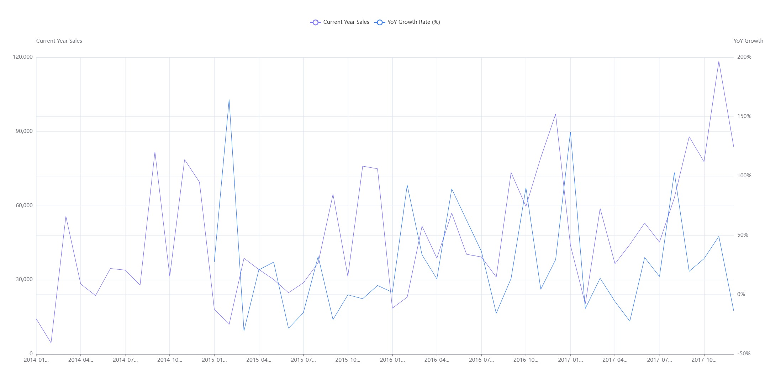

Slide 8
Discount's impact on sales, profit
Weak Negative Correlation with Sales: 'Discount' and 'Sales' have a very weak negative correlation of -0.03, indicating minimal impact on sales.
Moderate Negative Correlation with Profit: 'Discount' and 'Profit' show a moderate negative correlation of -0.22, suggesting a more noticeable decrease in profit.
Impact on Profitability: Discounts have a detrimental effect on profitability.

Slide 9
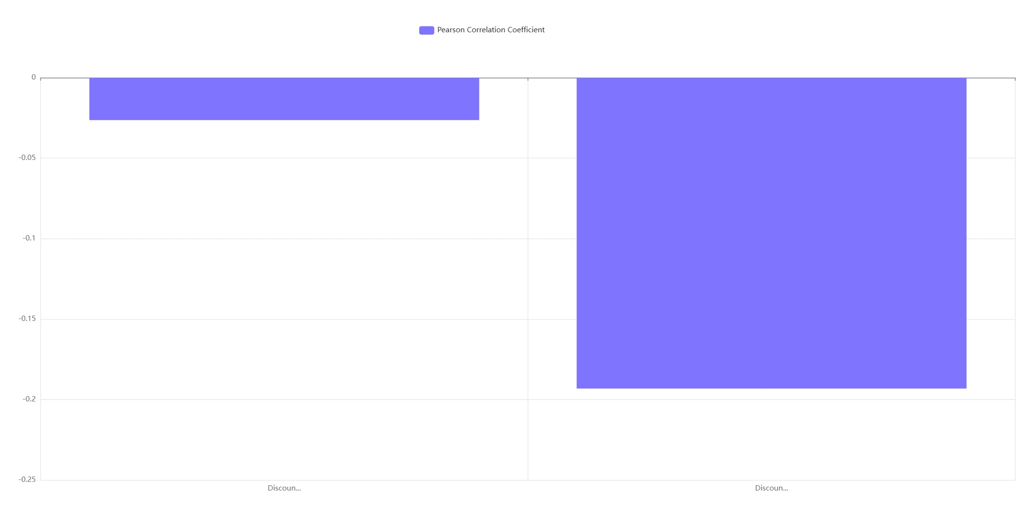

Slide 10
Identify Outlier Orders by 3σ
Outlier Identification: 127 orders identified as outliers using the 3σ rule, with sales ranging from 2104.55 to 22638.48.
Profit Variability: Outliers show a wide profit range from -6599.98 to 8399.98, indicating no consistent correlation between extreme sales and profits.
Visualization Gap: Scatter plot failed to display data, necessitating further analysis for better understanding of sales-profit relationships.

Slide 11
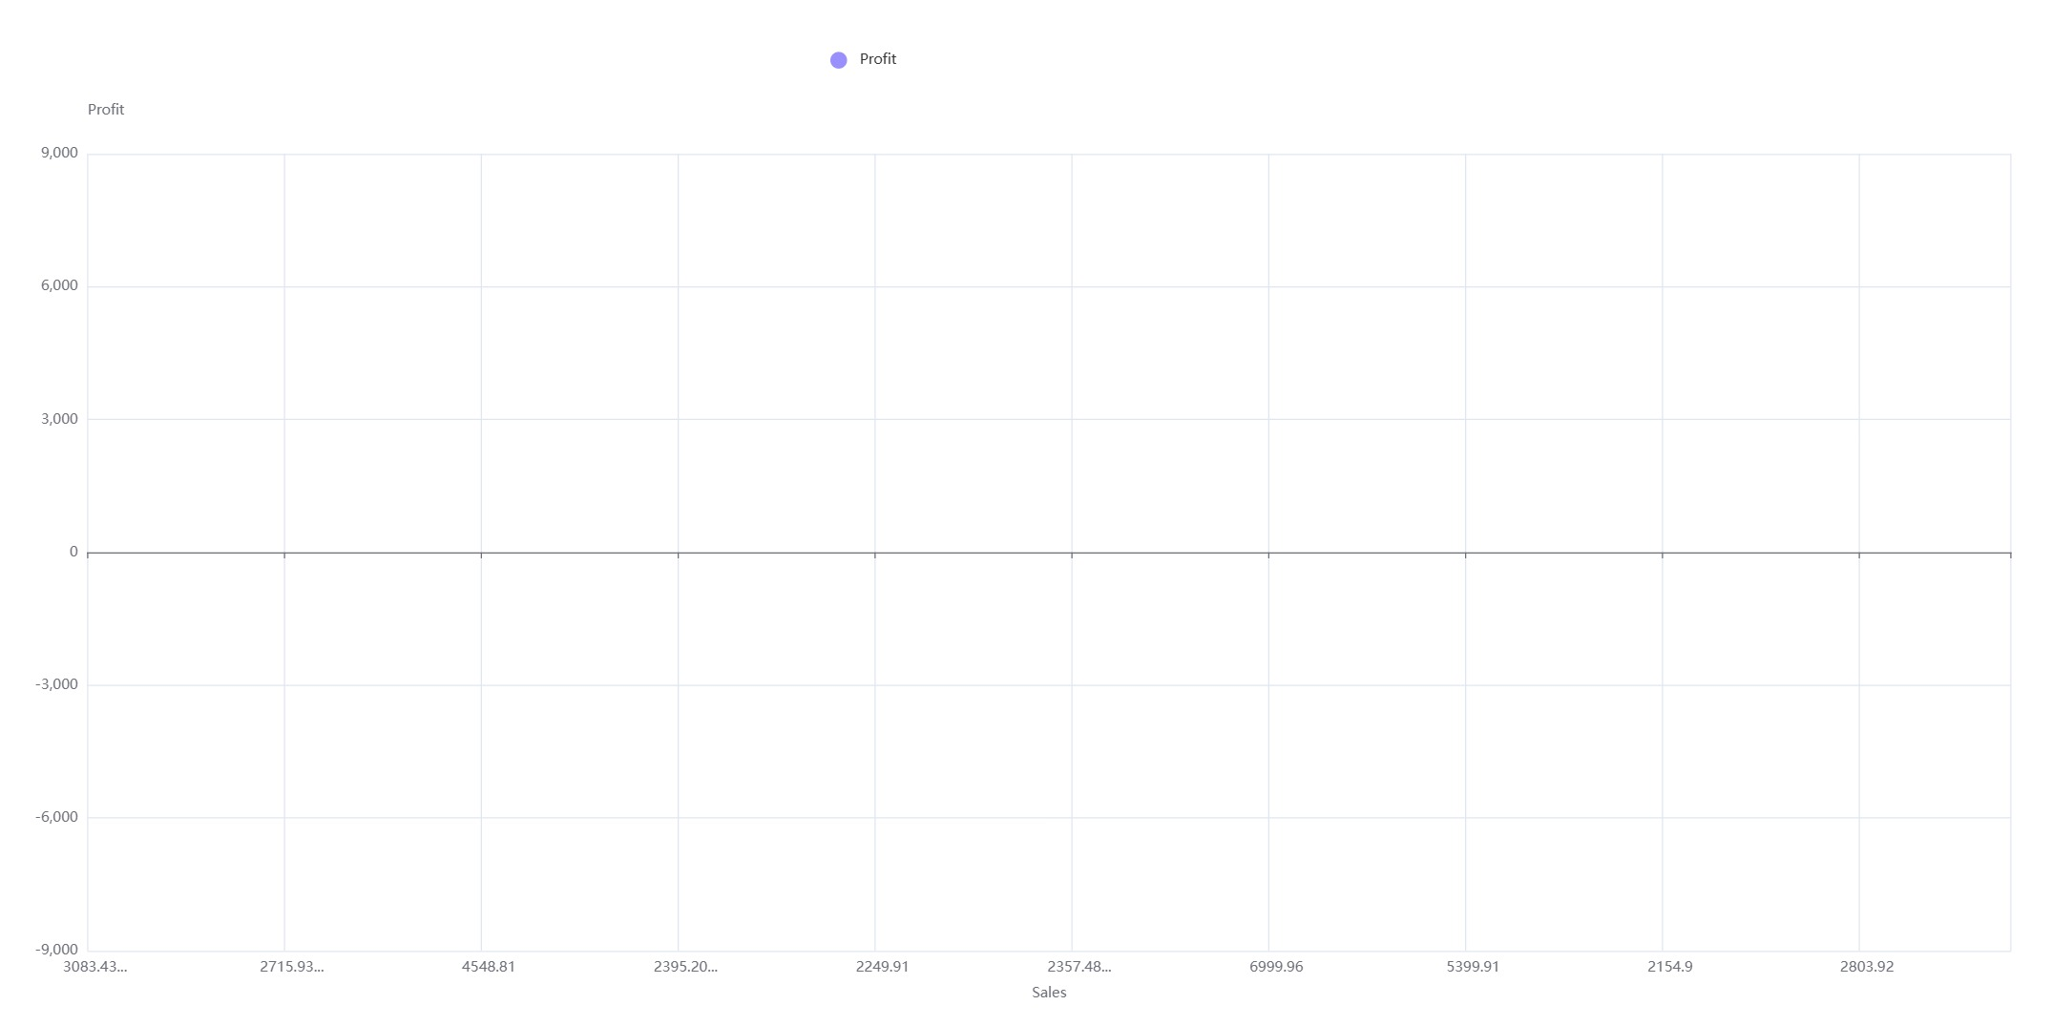

Slide 12
Sales by Customer Segment RFM
Consumer Segment Dominance: The Consumer segment leads in total sales, with Loyal Customers and Champions as top contributors.
High-Value Customer Segments: Across all segments, 'Loyal Customers' and 'Champions' are key sales drivers.
Strategic Focus: Emphasize re-engagement of 'At Risk' and conversion of 'Potential Loyalists' for growth.

Slide 13
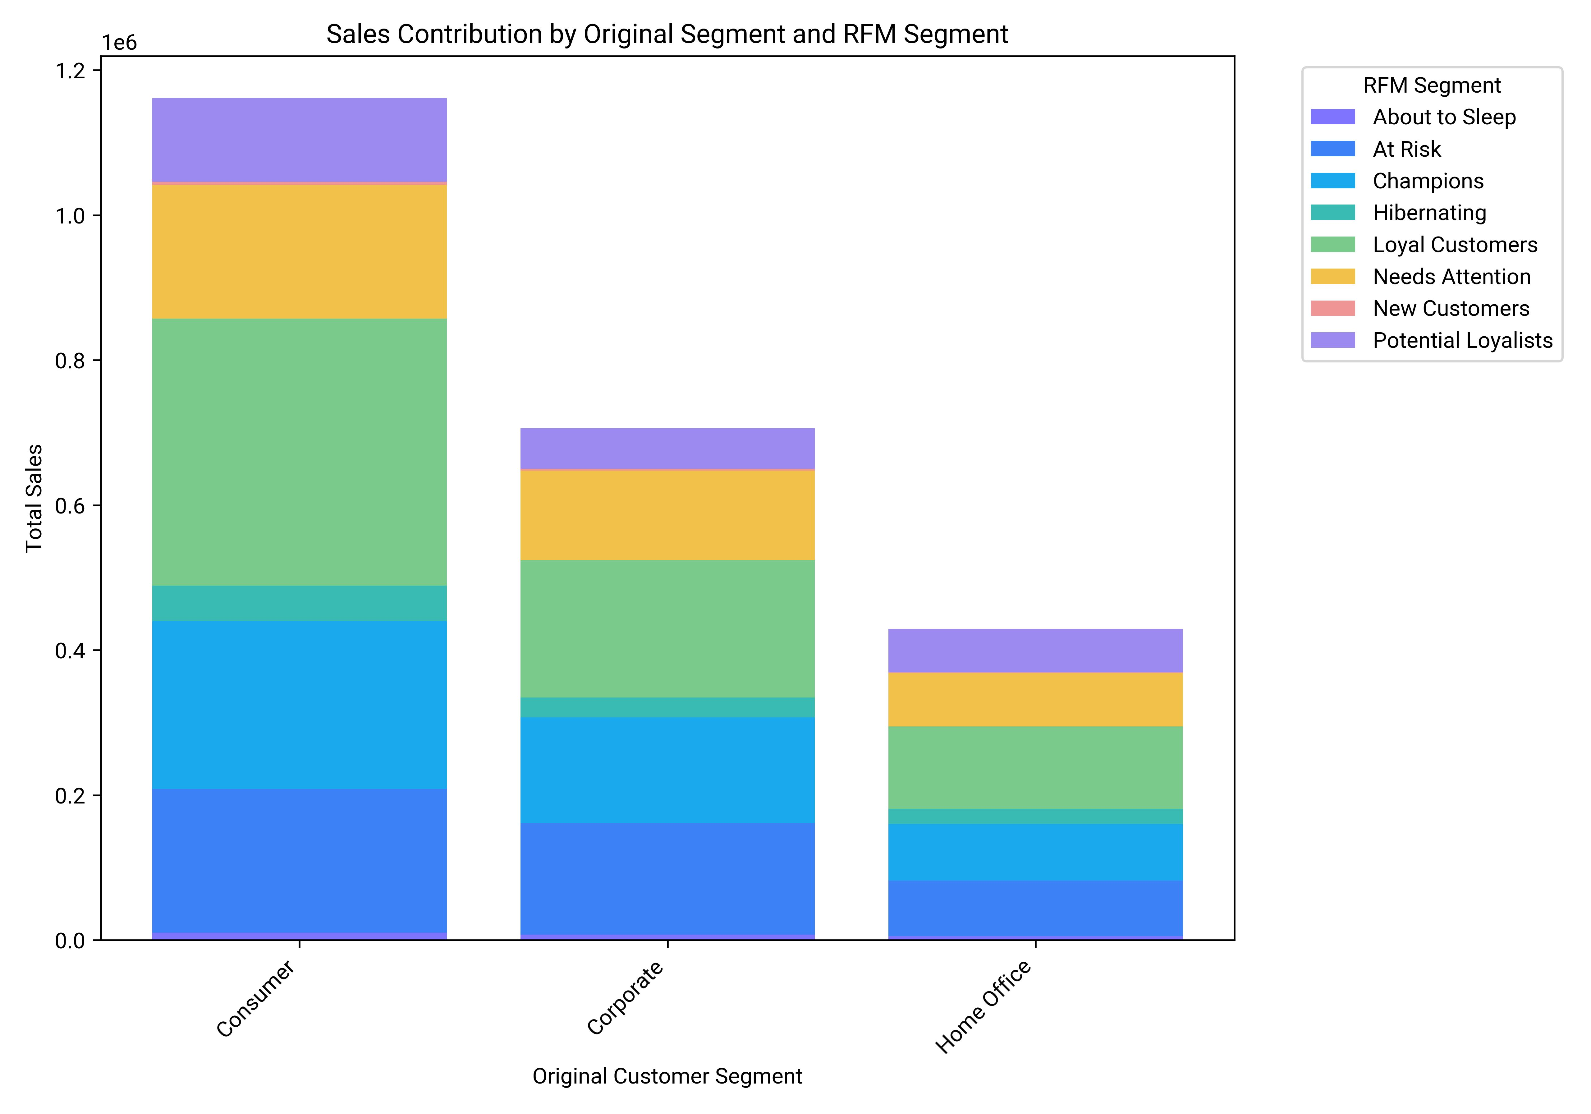

Slide 14
Sales, Profit, Margin by Category
Technology leads in both sales (836,154.03) and profit (145,454.95) with the highest profit margin of 17.40%.
Office Supplies shows strong profitability with a profit margin of 17.04%, despite lower sales than Furniture.
Furniture has the lowest profitability, with a profit margin of 2.49%.

Slide 15
Total Sales by State Analysis
Overall Sales Performance: The average sales across all states is $46,881.65, with 38 out of 49 states below this average.
Top Performers: California ($457,687.63) and New York ($310,876.27) lead in sales, significantly exceeding the average.
Visual Insights: A bar chart highlights states below average in red, aiding in identifying underperforming states for strategic focus.

Slide 16
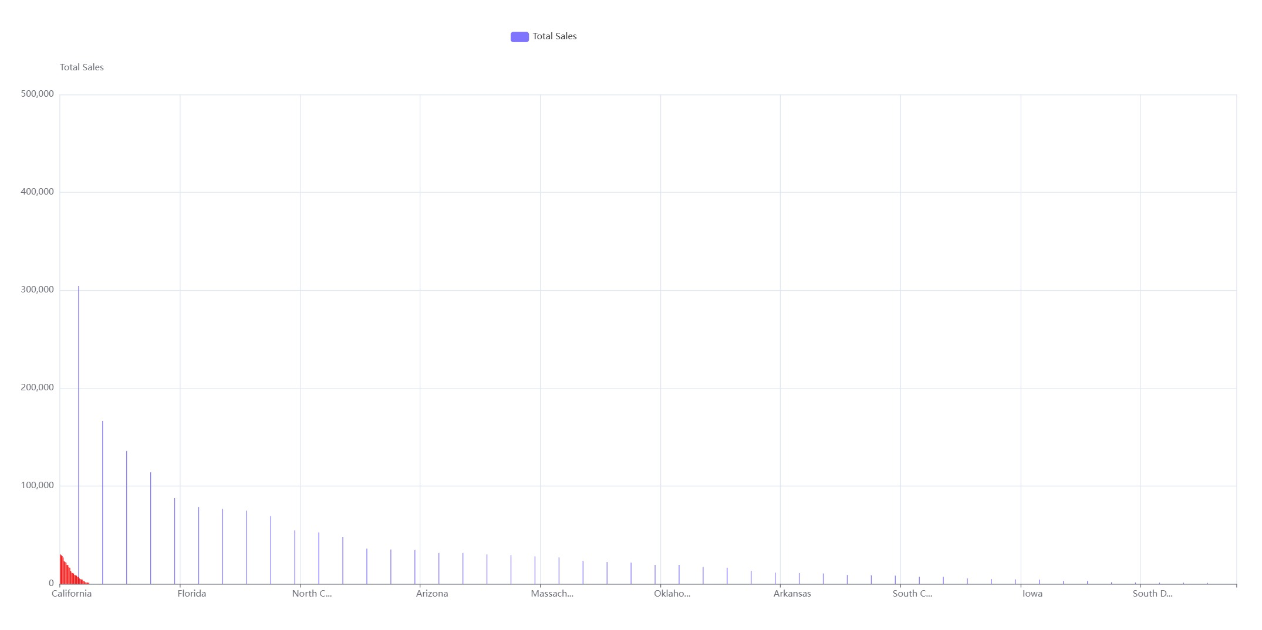

Slide 17
Order distribution by ship modes
Order Distribution: Standard Class is the most used ship mode with 5,968 orders, while Same Day is the least used with 543 orders.
Visual Insights: Bar chart confirms Standard Class dominance and Same Day's minimal usage.
Conclusion: Standard Class is preferred for cost-effectiveness; Same Day is less utilized due to higher costs or specific needs.

Slide 18
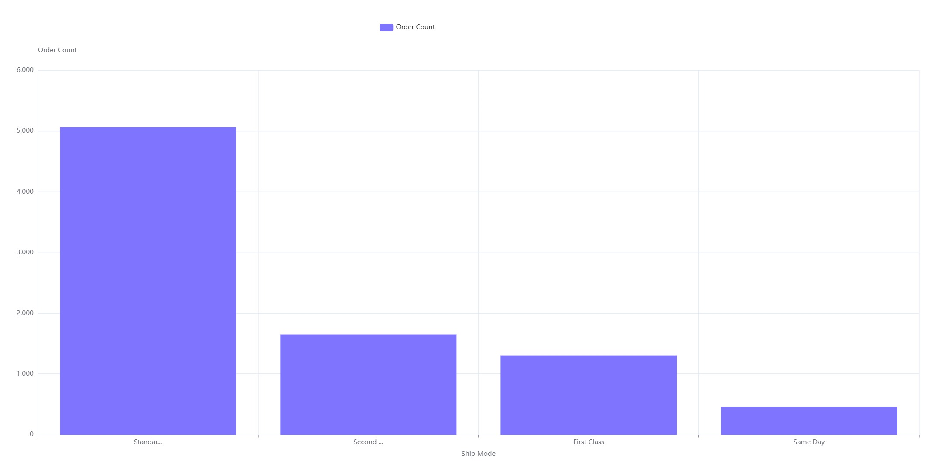

Slide 19
Sub-category profit analysis
Overall Profit Performance: Sub-categories show varied financial outcomes, with some generating significant profits and others incurring losses.
Loss-Making Sub-Categories: Bookcases, Supplies, and Tables have negative profits.
Magnitude of Losses: Tables incur the largest loss at -17725.48, followed by Bookcases and Supplies.

Slide 20
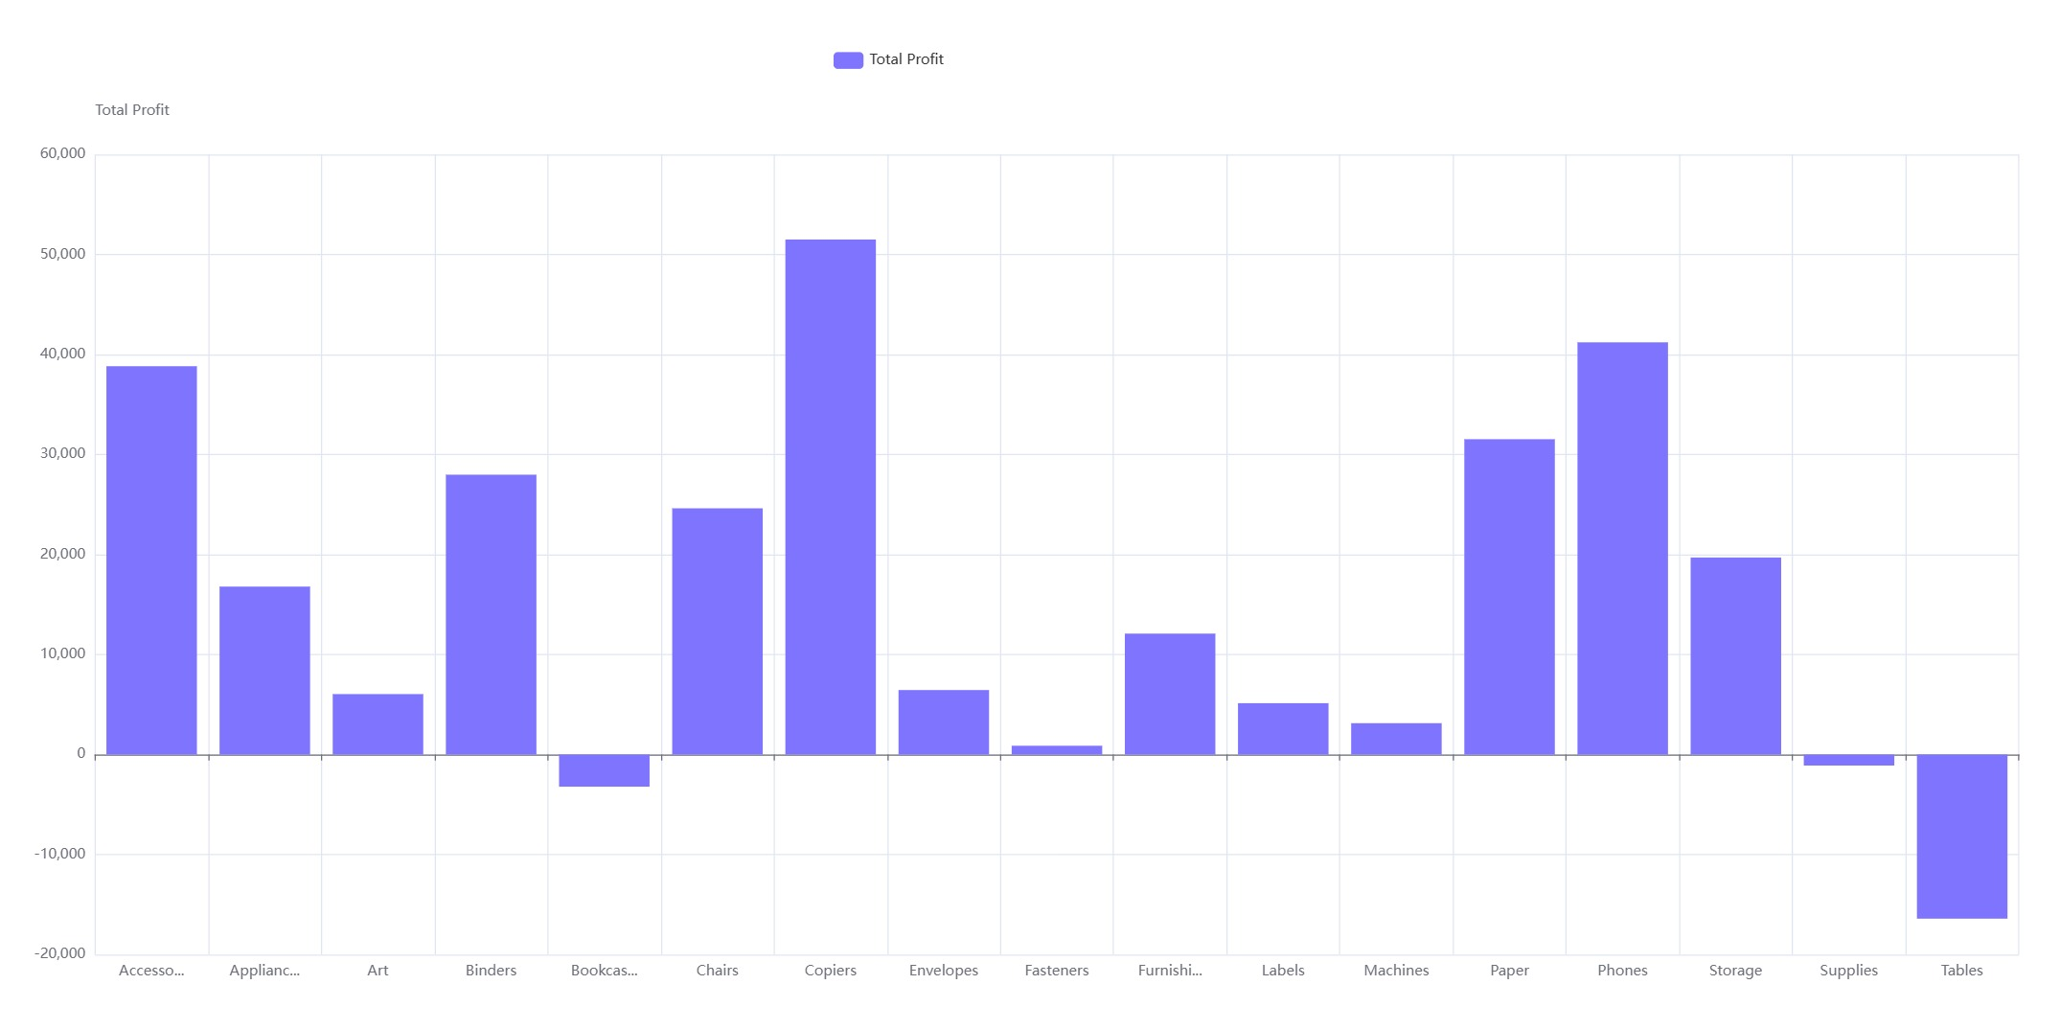

Slide 21
Top products by customer segment
Dominant Category: Office Supplies is the most purchased category across all segments: Consumer, Corporate, and Home Office.
Segmental Purchase Volume: The Consumer segment leads with 11,758 units, followed by Corporate with 7,018, and Home Office with 4,130 units, indicating higher consumer demand.

Slide 22
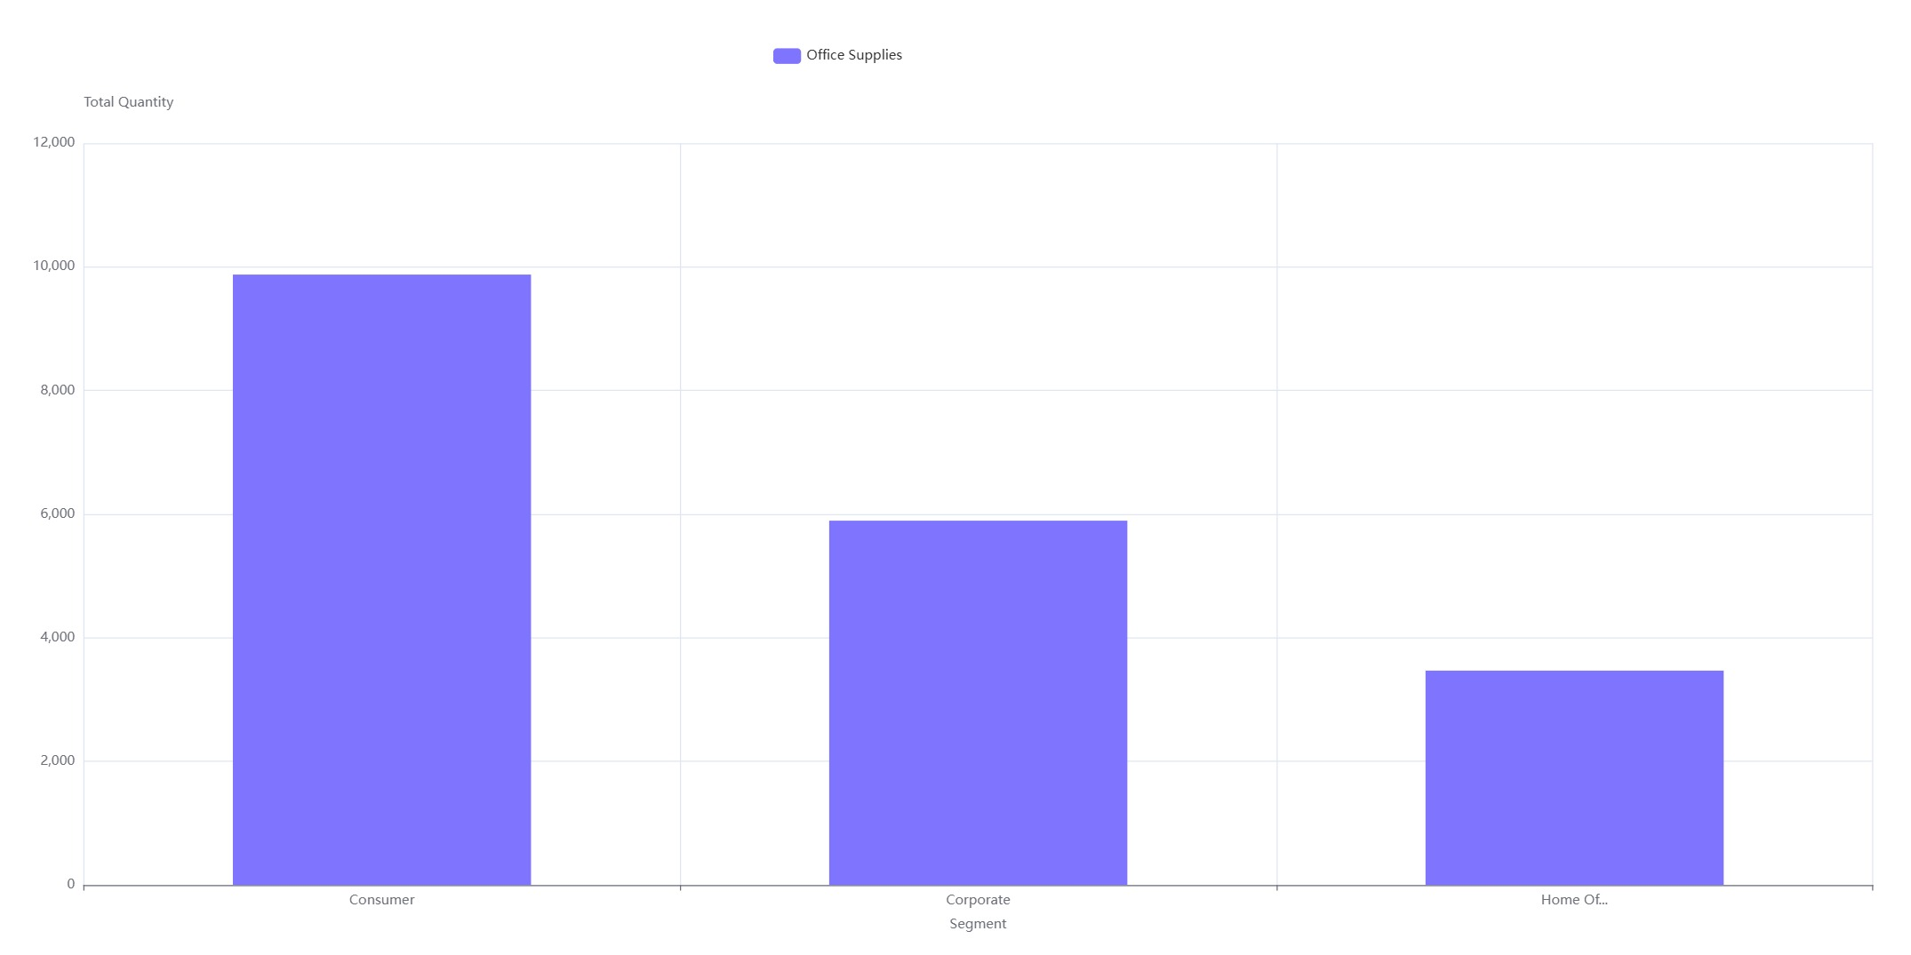

Slide 23
Order fulfillment time by mode
Fastest Fulfillment: 'Same Day' mode, with a mean and median of 0 days.
Slowest Fulfillment: 'Standard Class', averaging 5 days, max 7 days.
Consistency: 'Same Day' and 'First Class' have lower standard deviations (0.21 and 0.77 days), indicating consistent fulfillment.
Fulfillment Range: Increases from 0-1 day ('Same Day') to 3-7 days ('Standard Class').

Slide 24

Email
Name

